Slide 1
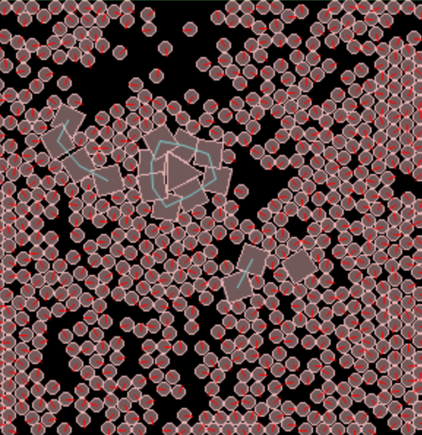
Liquid Automata
Dr Steve Battle UWE Bristol
Festival of Unconventional Computing and Proto-cognition

Slide 2
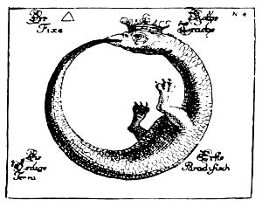
Autopoiesis
From Greek:
“auto” (self)
“poiesis” (creation)
Autopoiesis is synonymous with life.

Slide 3
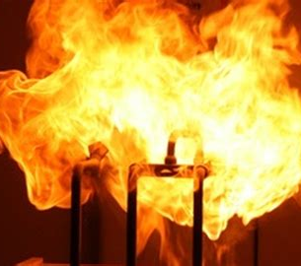
Organisational Closure
A network of processes of self-production of components.
examples:
chemical reactions
fire
nuclear bomb
Covid virus
Krebs cycle

Slide 4
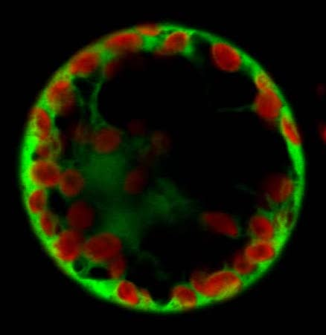
Structural Closure
The emergence of a boundary dividing self from non-self.
examples
cell wall
crystals
soap bubble
corral

Slide 5
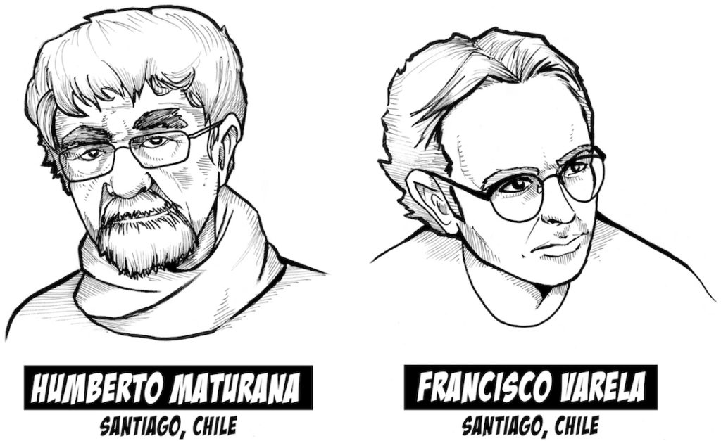
Living Machines
Life = Organisational Closure
+ Structural closure
“A universe comes into being when a space is severed into two. A unity is defined.”
Autopoiesis and Cognition: The Realization of the Living (1972)

Slide 6
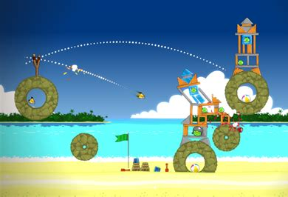
Liquid Automaton
Take a game physics engine – the one from “Angry Birds”
Add chemistry…

Slide 7
Artificial Chemistry
+
+
→
+
composition
+
→
concatenation
→
+
disintegration
Organisation closure

Slide 8
Artificial Autopoiesis
Particles move freely in 2D space.
React ‘chemically’ when they collide.
Closed boundary forms, like a cell wall, enclosing the (triangular) catalyst.

Slide 9
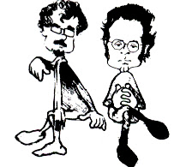
Conclusion and Question
“Living systems are cognitive systems, and living as a process is a process of cognition. This state­ment is valid for all organisms, with and without a nervous system.”
Autopoiesis and Cognition: The Realization of the Living (1972)
Is proto-cognition a better word?

